Slide 1
Medical College of Wisconsin
Program Director - Thomas Carver, MD FACS
Assistant Program Director – Anu Elegbede, MD FACS
Assistant Program Director – Jeremy Levin, MD FACS
Program Coordinator – Laurie Hein

Slide 2
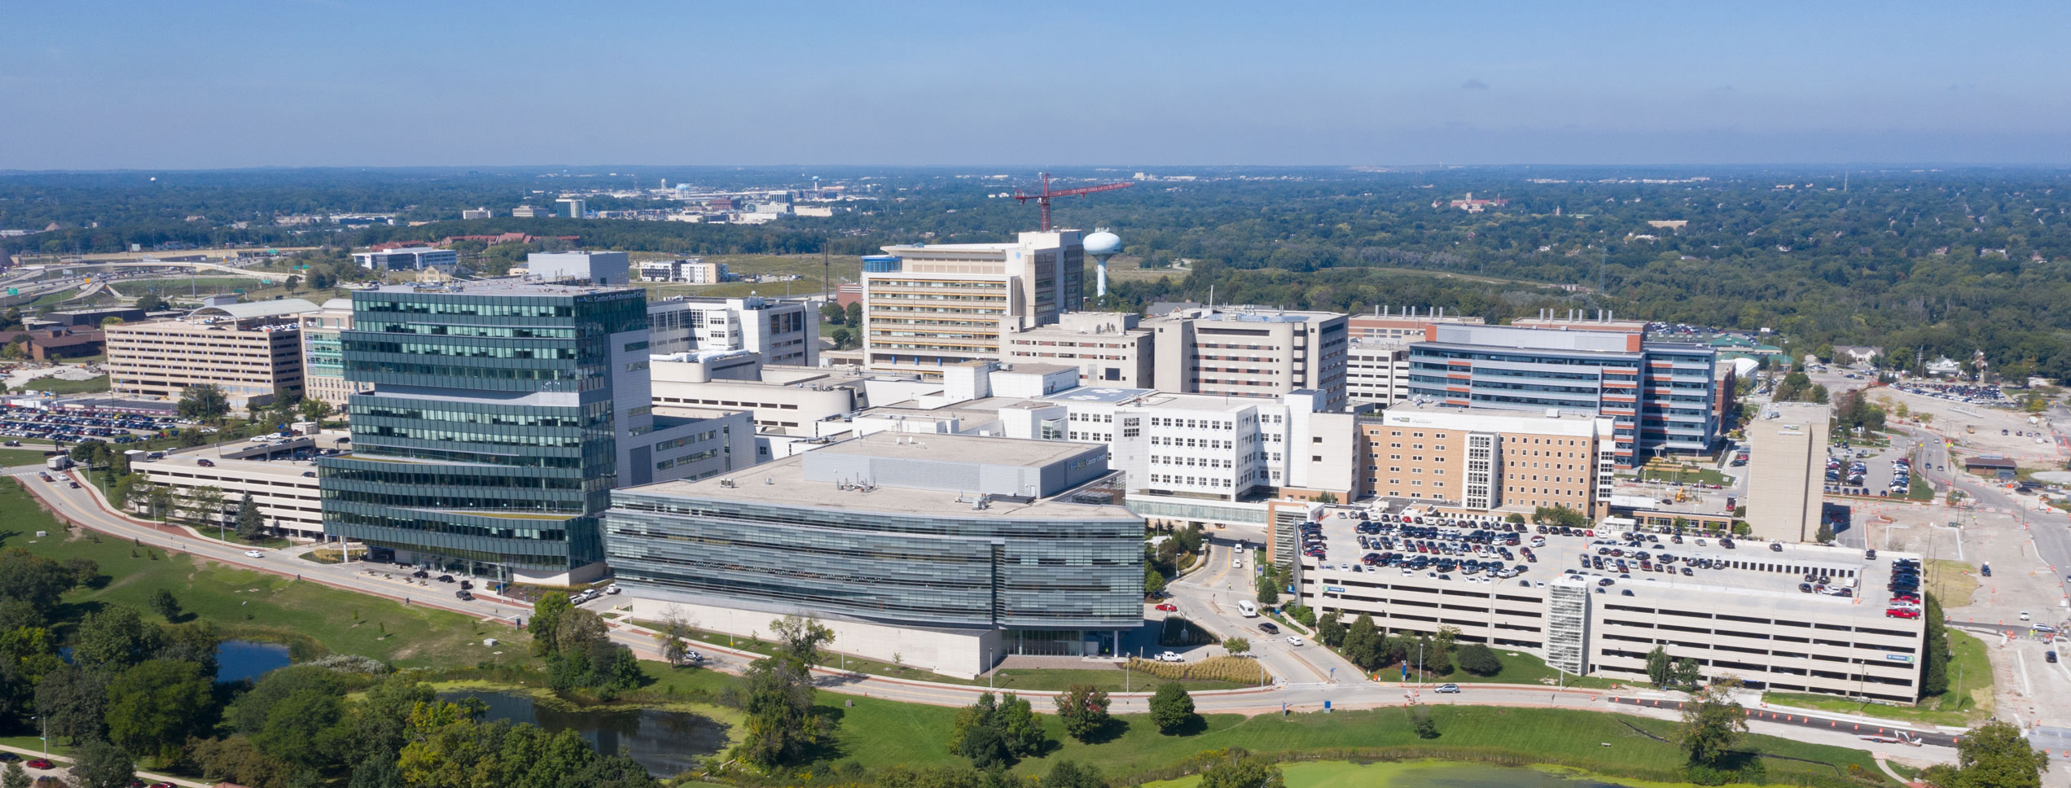
Our Campus

Slide 3
General Overview
Froedtert Memorial Lutheran Hospital (Milwaukee WI)
  650 bed hospital
  3200 Trauma Admissions
  20% Penetrating
SCC 1 fellow/year
ACS 1 fellow/year (AAST Approved in 2019)
Faculty
  18 Trauma/Critical Care
  2 In-house (1 ICU/1 Trauma)

Slide 4
SCC Rotations
SICU Froedtert – 4.5 months Research/Ultrasound – 1 month
SICU VA – 2.5 months CVICU – 1 month
SICU St Lukes – 1 month Trauma or ACS – 2 weeks
NICU St Lukes – 1 month Childrens ICU – 2 weeks

Slide 5
ACS Rotations
Trauma – 3 - 4 months Electives (potential)
ACS – 3 - 4 months - Abdominal wall
Vascular – 6 weeks - Complex Wound Care
Research/US – 1 month - Pre-hospital (EMS)
International (Panama) – 1 month
Elective – 2 weeks

Slide 6
SCC
SICU FMLH and VA (Trauma/EGS and Surgical Subspecialty)
  SICU FMLH has ~ 2000 admissions/yr
  Fellow is responsible for management of all patients
CVICU – experience with cardiac patients
  Mechanical support devices
  ECMO
St Lukes – Large Community Program
  Neuro ICU
  SICU (transplant and complex general surgery)

Slide 7
ACS Day to Day
Trauma has 2 teams
  Fellow runs 1 team with a PGY4 and APPs
  PGY5 runs other team
  Operative cases follow the surgeon
ACS splits when fellow is on
  Fellow and resident/APP – all call admissions/operations fellow did
  PGY5 – keeps admissions/operations
3 weeks of service/1 week admin
Twice a month elective clinic

Slide 8
Didactics/Education
SCC year – “Fellow Free Fridays”
  Friday is dedicated academic/admin
    AM – combined with Anesthesia CC
    PM – combined with Pulm/CC
  Curriculum based off SCORE and supplemented with lectures
ACS year
  Twice a month afternoons are academic time
    Matched to AAST Meet the Mentors
    1:1 discussion with faculty - 12 predetermined topics
  1-2 a month review of interesting cases

Slide 9
ACS Supervision
First 3 months
  In room for every operation
  Faculty respond with fellow for alerts
Next 3 months
  In room/scrubbed for specific operations
  Selective alerts
At 6 months – performance review and decision on supervision
2nd half of fellowship (if appropriate)
  In room for specific operations
  Alerts PRN

Slide 10
ACS Unique Elements
No specific HPB rotation
  Organ procurements with TXP instead
  Fellow is “on-call” for any procurement
  Liver/kidney mobilization, sternotomy, visceral rotations
6 weeks vascular
Dedicated US rotation/experience
International rotation (Panama)
Community ACS rotation
Fellow has own clinic for elective cases

Slide 11
Questions
We are happy that you are considering us!
Please don’t hesitate to reach out to any of us if you have other questions
Laurie Hein – Lhein@mcw.edu
Thomas Carver – tcarver@mcw.edu
Anu Elegbede – aelegbede@mcw.edu
Jeremy Levin– jlevin@mcw.edu

